Slide 1
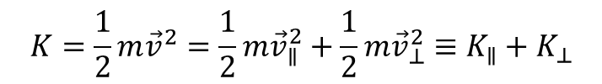




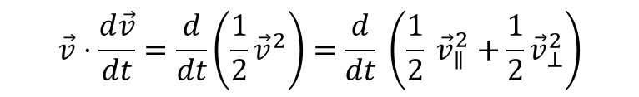

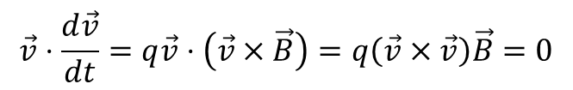

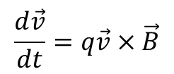
$$\hat{B}$$
$$\vec{v}$$
$$K=\frac{1}{2}m{\vec{v}}^{2}=\frac{1}{2}m{\vec{v}}_{∥}^{2}+\frac{1}{2}m{\vec{v}}_{⊥}^{2}≡K_{∥}+K_{⊥}$$
$${\vec{v}}_{∥}$$
$$\frac{d\vec{v}}{dt}=q\vec{v}×\vec{B}$$
$$\hat{y}$$
$$\vec{v}⋅\frac{d\vec{v}}{dt}=q\vec{v}⋅\left(\vec{v}×\vec{B}\right)=q\left(\vec{v}×\vec{v}\right)\vec{B}=0$$
$$\hat{x}$$
$${\vec{v}}_{⊥}$$
$$\vec{v}⋅\frac{d\vec{v}}{dt}=\frac{d}{dt}\left(\frac{1}{2}{\vec{v}}^{2}\right)=\frac{d}{dt} \left(\frac{1}{2} {\vec{v}}_{∥}^{2}+\frac{1}{2}{\vec{v}}_{⊥}^{2}\right)$$
So the total kinetic energy is conserved
The parallel energy is conserved iff the electric field is zero
Therefore the perpendicular energy is conserved

